Slide 1

Dev
Ops
&

Slide 2


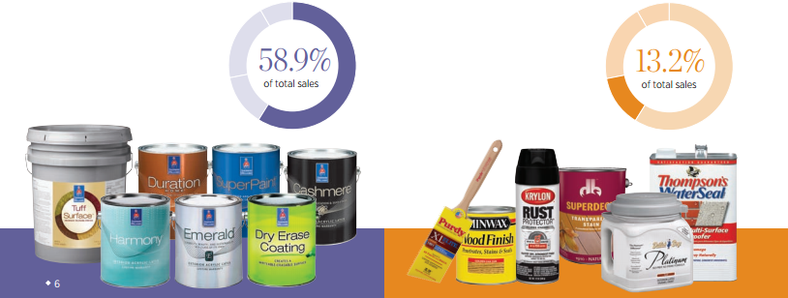
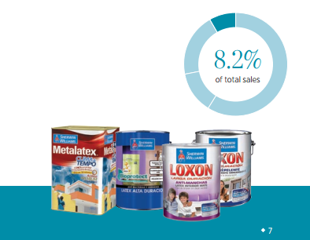
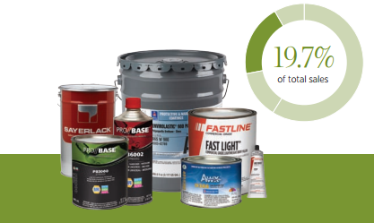
Introduction to Sherwin-Williams

Slide 3

My role at Sherwin-Williams
With Sherwin-Williams 8 years
IT Manager for Architecture and Continuous Delivery
Been in IT 13 years
Been an IT manager for 7 years
Favorite Superhero – Captain America

Slide 4

My role at Sherwin-Williams

Slide 5
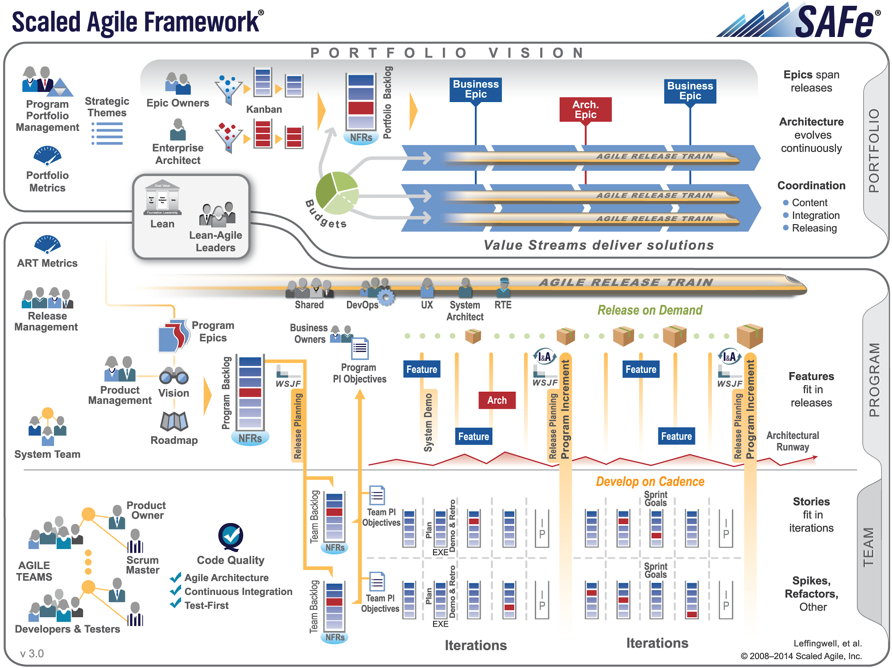

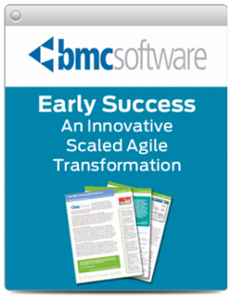


Scaled Agile Framework - SAFe

Slide 6

DevOps
“You keep using that word. I do not think it means what you think it means”
-Inigo Montoya (The Princess Bride)

Slide 7
DevOps is not …
Separate Silos
Dev
Ops

Slide 8
DevOps is not …
Separate DevOps Silo
Dev
Ops
DevOps

Slide 9
DevOps is not …
“We Don’t Need Ops”
Dev
Ops
DevOps

Slide 10
DevOps is …
Smooth Collaboration
Dev
Ops

Slide 11
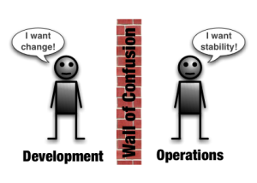
What is DevOps to Sherwin-Williams?
It’s not a team or title …
DevOps means focusing on improving standards, collaboration and automation to increase reliability, productivity, responsiveness and quality across Development and Operations.
Image from - dev2ops.org
Break down the wall between development and operations

Slide 12
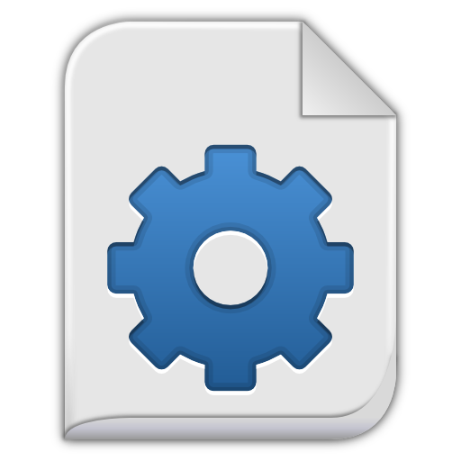

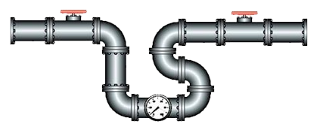
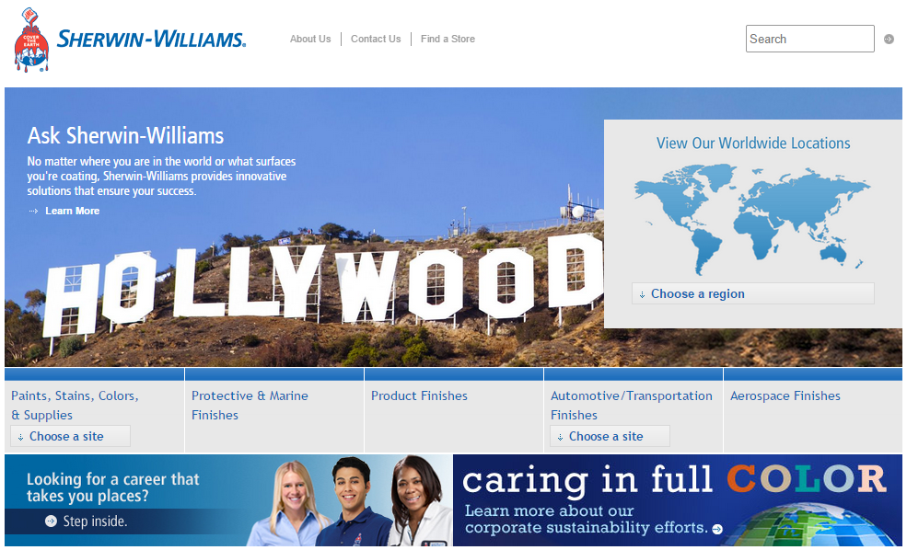

DevOps is …
More collaboration and automation between the development and operations teams = larger pipeline

Slide 13
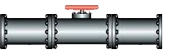
DevOps is …
Remove the hand offs – streamline the process, challenge everything that doesn’t add value.

Slide 14
DevOps
One team cannot do it all …
Must be a joint collaboration effort!
Code
Environments
Data
Tests

Slide 15
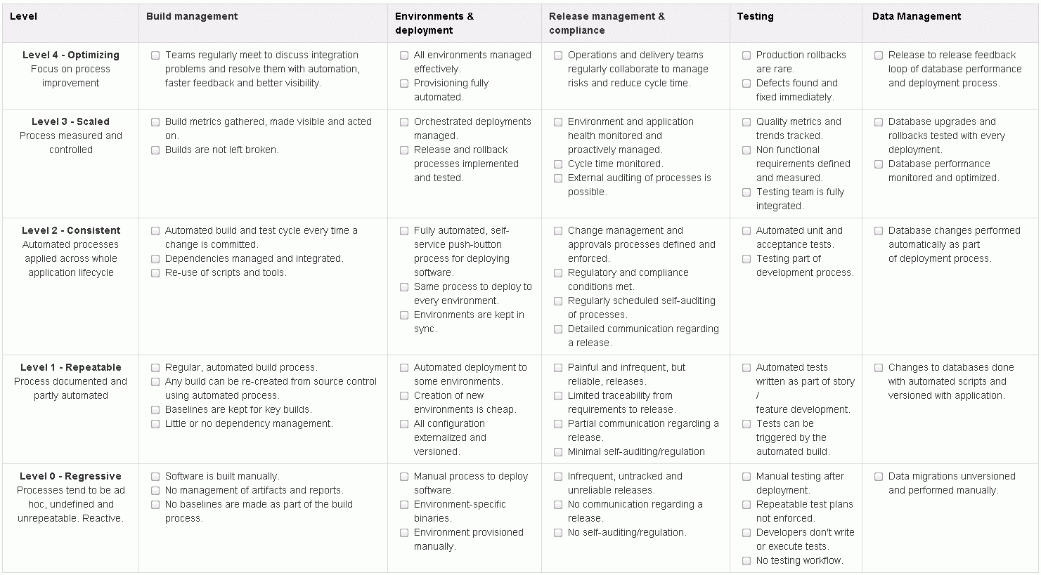
Maturity Model
Code
Environments
Process
Tests
Data

Slide 16
Maturity Model Example
Level 0 - Regressive
Level 4
Manual Process to deploy software
Environment-specific binaries
Environment provisioned manually
Level 3
Environments
Level 2
Level 1
Level 0

Slide 17
Maturity Model Example
Level 1 - Repeatable
Level 4
Automated deployment to some environments
Creation of new environments is cheap
All configuration externalized and versioned
Level 3
Environments
Level 2
Level 1
Level 0

Slide 18
Maturity Model Example
Level 2 - Consistent
Level 4
Fully automated, self-services push-button process for deploying software
Same process to deploy to every environment
Environments are kept in sync
Level 3
Environments
Level 2
Level 1
Level 0

Slide 19
Maturity Model Example
Level 3 - Scaled
Level 4
Orchestrated deployments managed
Release and rollback processes implemented and tested
Level 3
Environments
Level 2
Level 1
Level 0

Slide 20
Maturity Model Example
Level 4 - Optimizing
Level 4
All environments managed effectively
Provisioning fully automated
Level 3
Environments
Level 2
Level 1
Level 0

Slide 21
Code
Code
Development
Configuration
Management
Operations

Slide 22


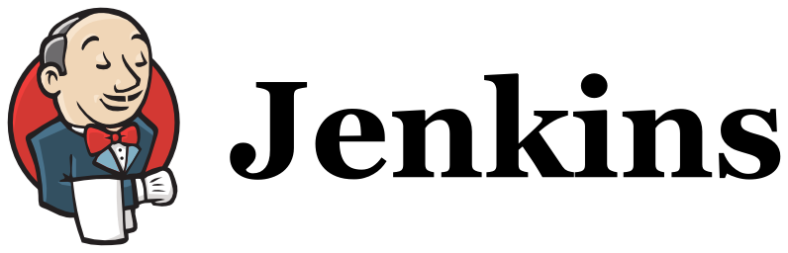


CM + Operations + Development
Build a bigger and better deployment pipeline, through consistency and reproducibility while leveraging automation.
Code

Slide 23


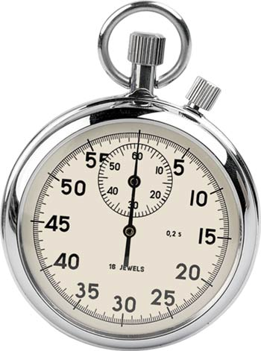
CM + Operations + Development
Just a few build stats …
1100
Jenkins jobs across 3 servers
46,562
Build job executions in the last year
2.5 minutes
a deployment happens

Slide 24
Environments
Environ ments
Development
Configuration
Management
Operations
Server Team

Slide 25




CM + Ops + Server + Development
Creating modular environments for local development all the way through production.
Environments

Slide 26

CM + Ops + Server + Development
400
Servers under control
233 seconds provision 16 servers
Server configs, App tier,
Web tier and code base

Slide 27
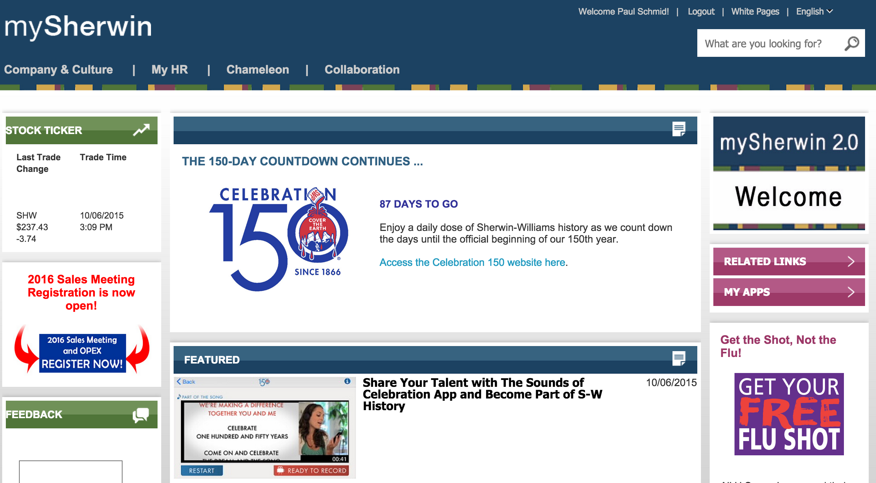
CM + Ops + Server + Development
15 minutes provision Oracle
Webcenter portal (8)
Webcenter content (4)
Webservers (4)
SSO integration
LDAP groups
Distributed cache layer
my.sherwin.com

Slide 28
Tests
Tests
Development
QA
APM

Slide 29


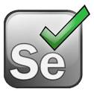
Development + QA + APM
Testing everything, automatically and at all tiers is critical to moving at the speed of light.
Tests

Slide 30
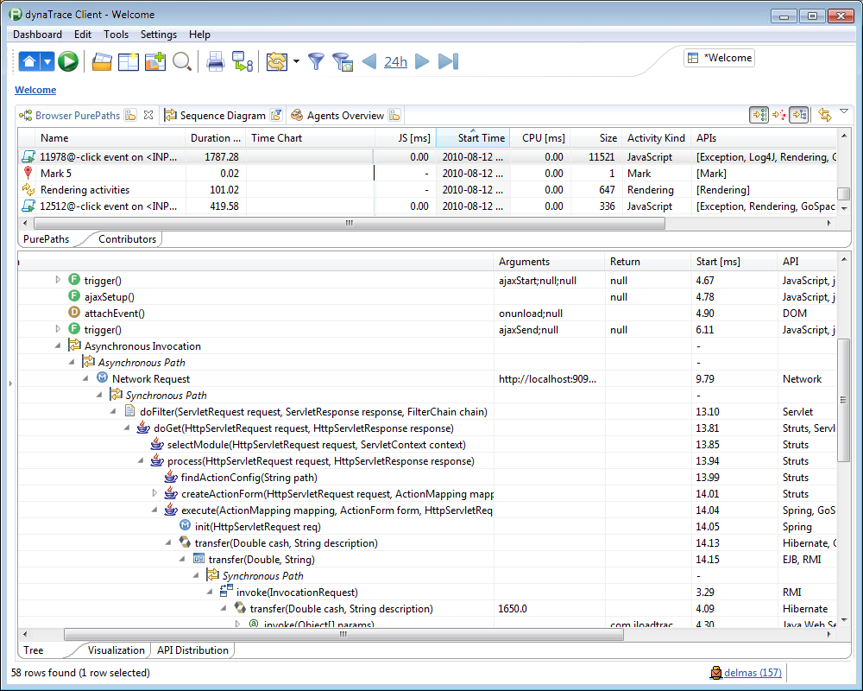
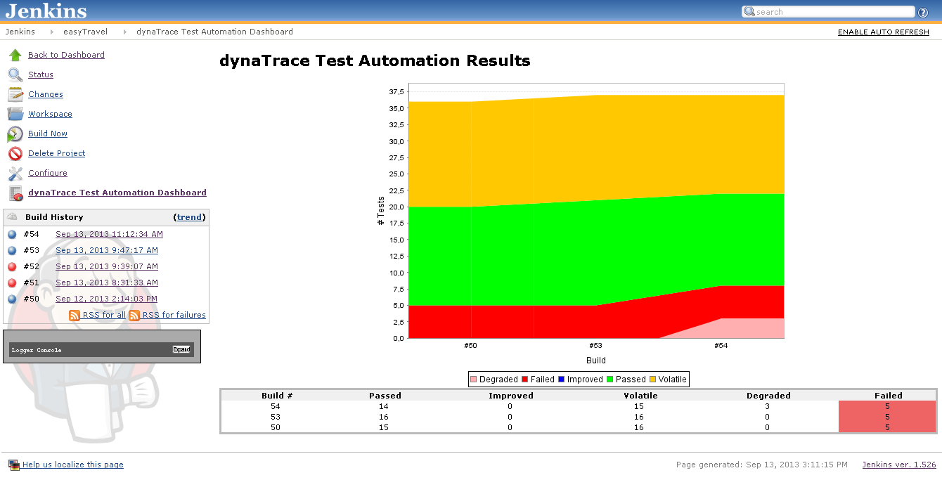
Development + QA + APM
Team Level
Transaction Regression Testing
Jenkins Integration

Slide 31
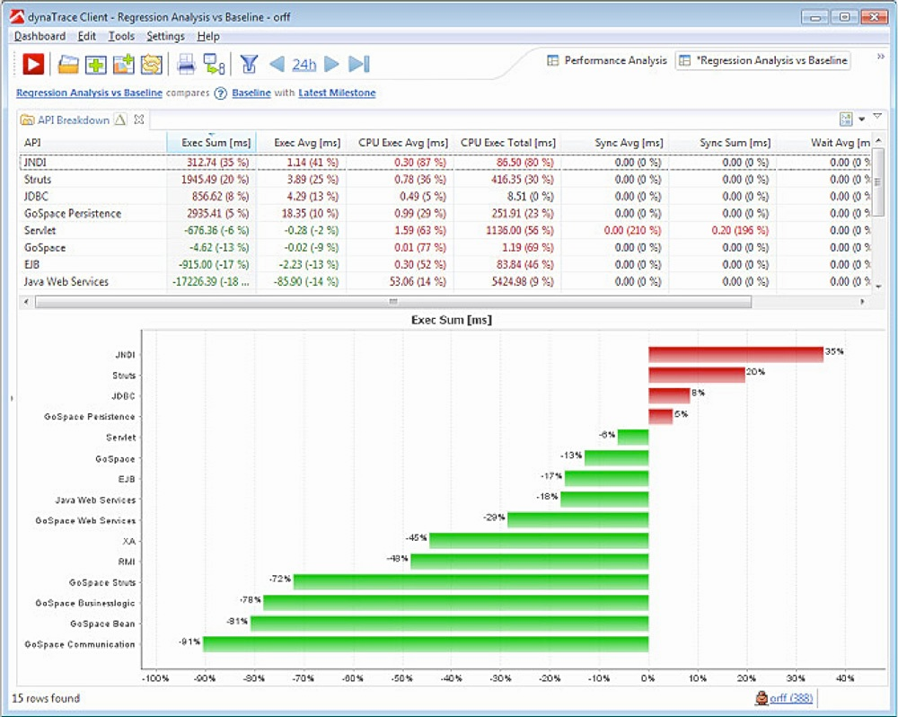
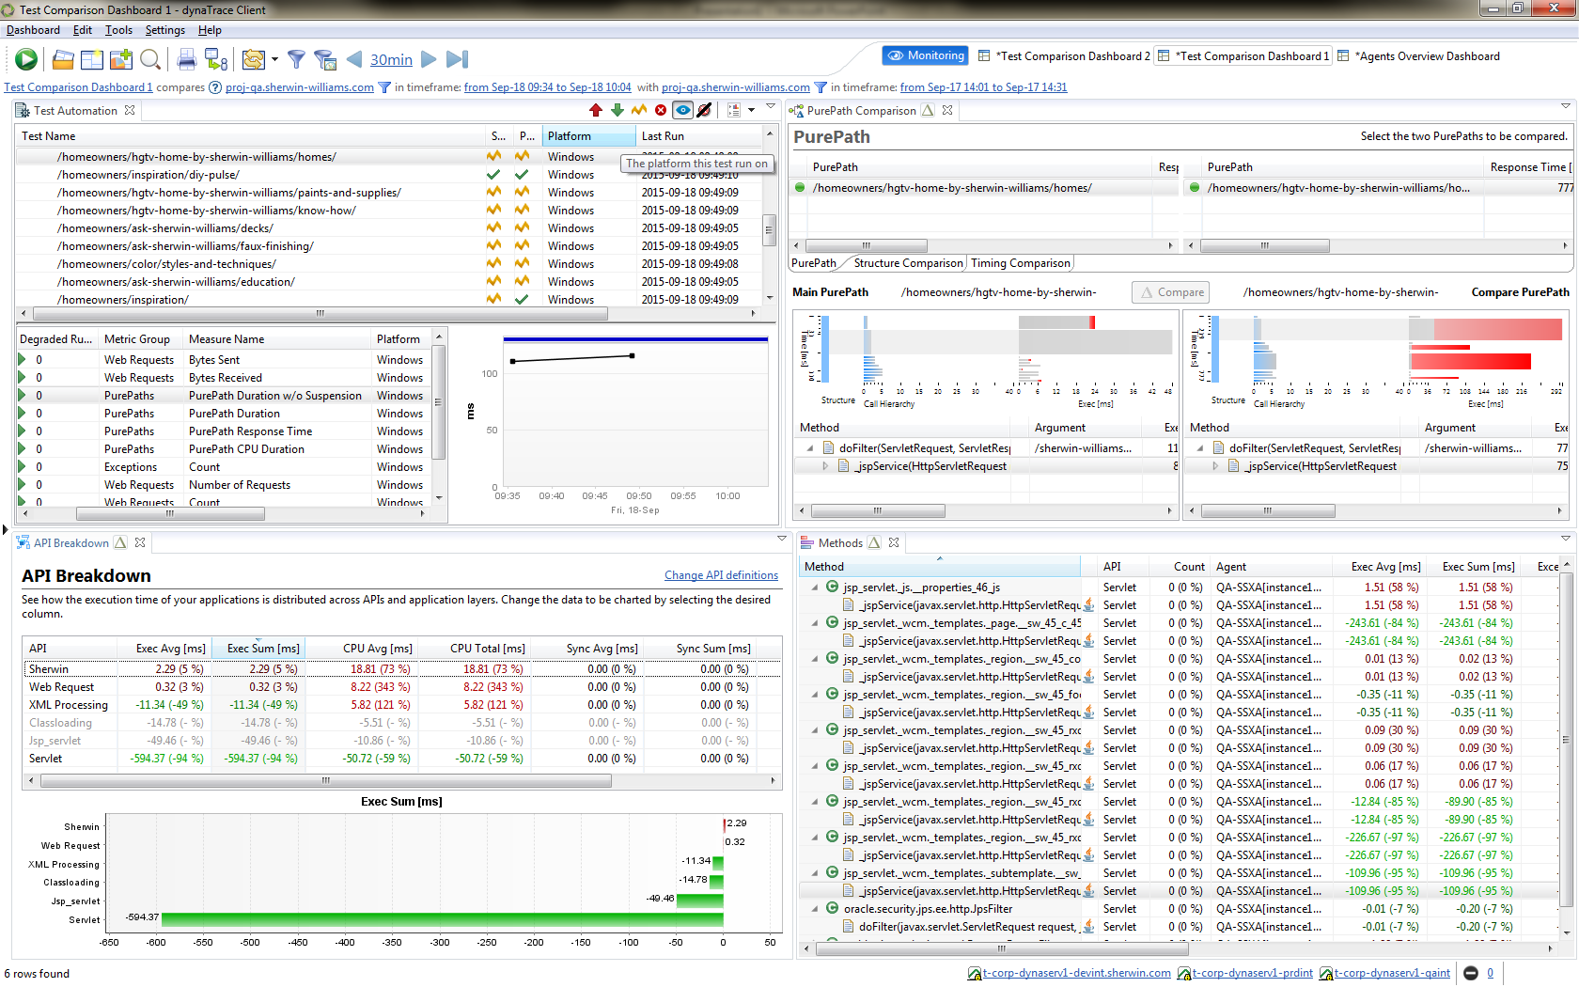
Development + QA + APM
Program Level
Automated Regression Testing
Code-Level Release Comparisons

Slide 32
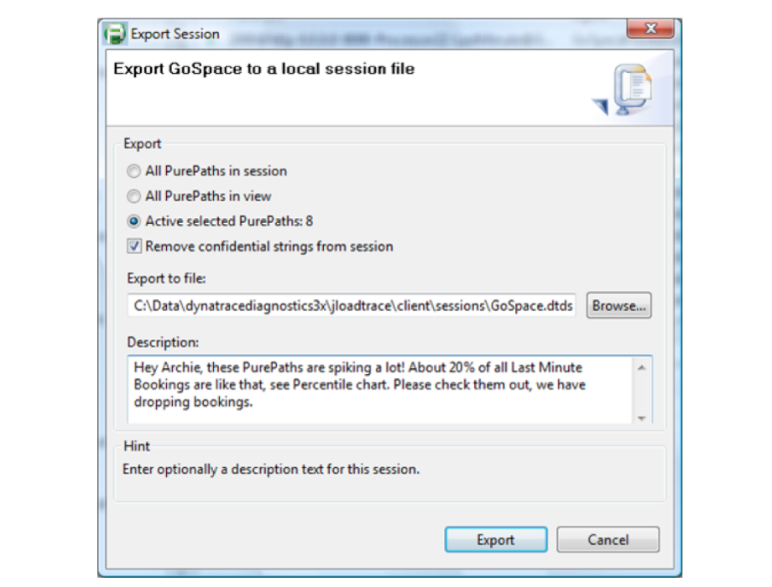
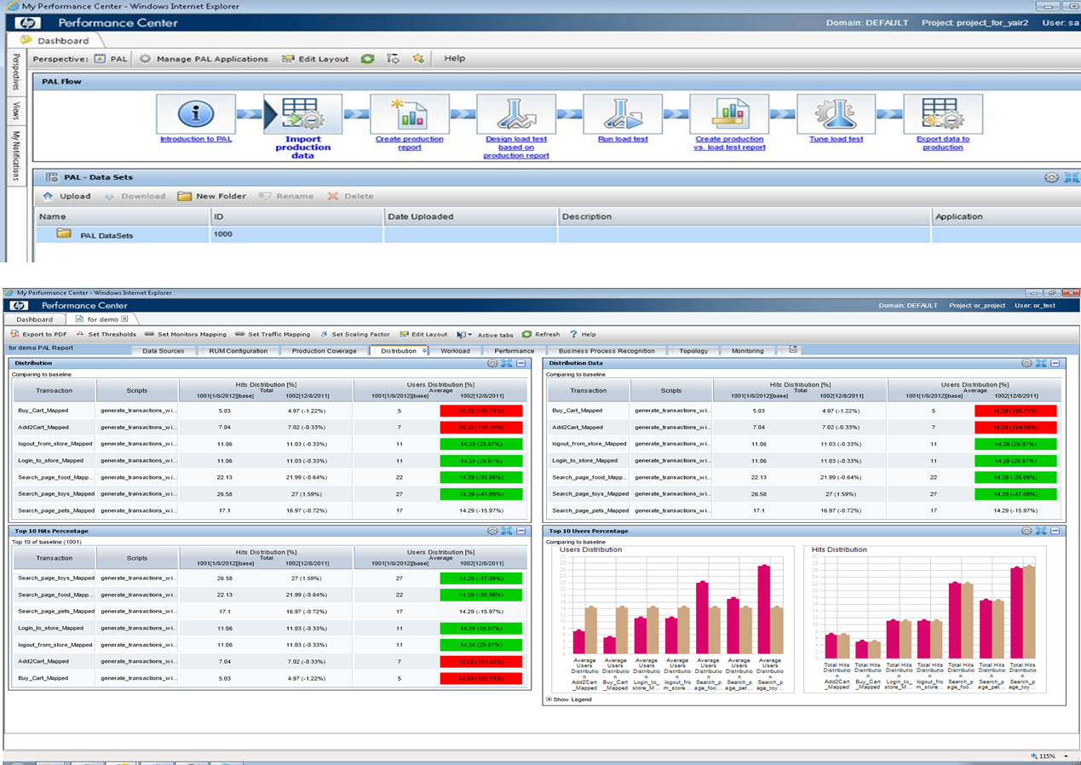
Development + QA + APM
Program Level
During performance testing
Package code-level root-causes

Slide 33
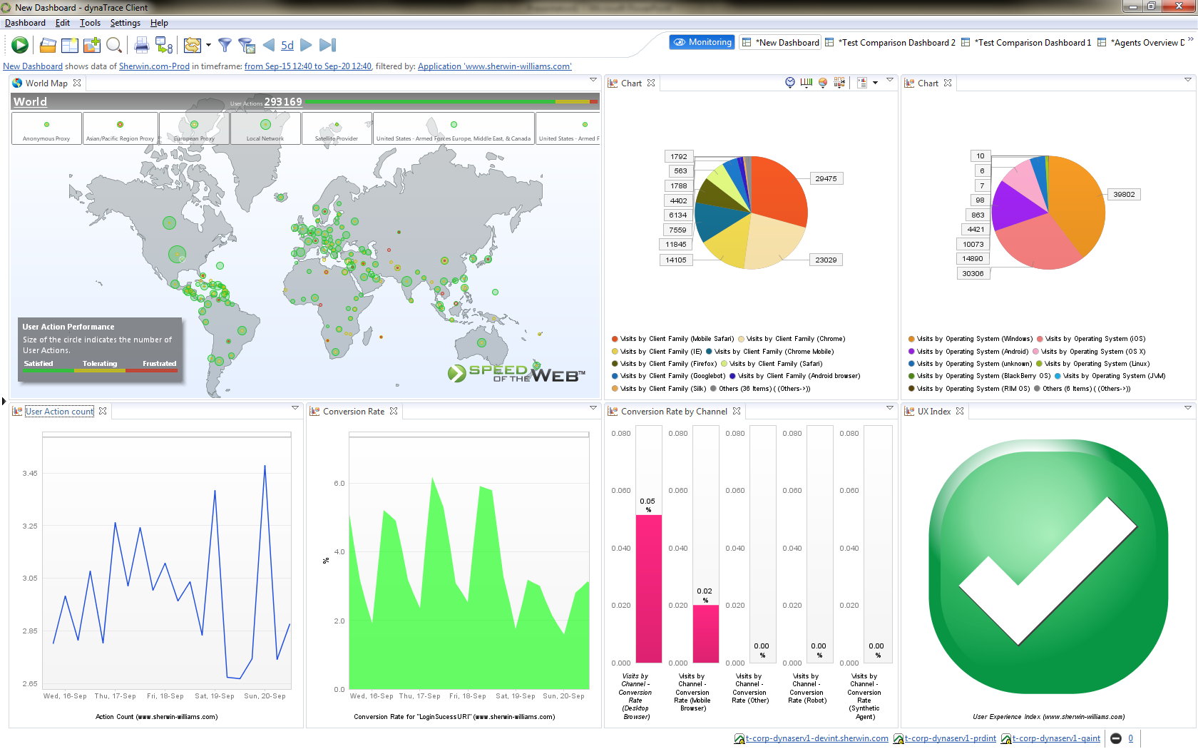
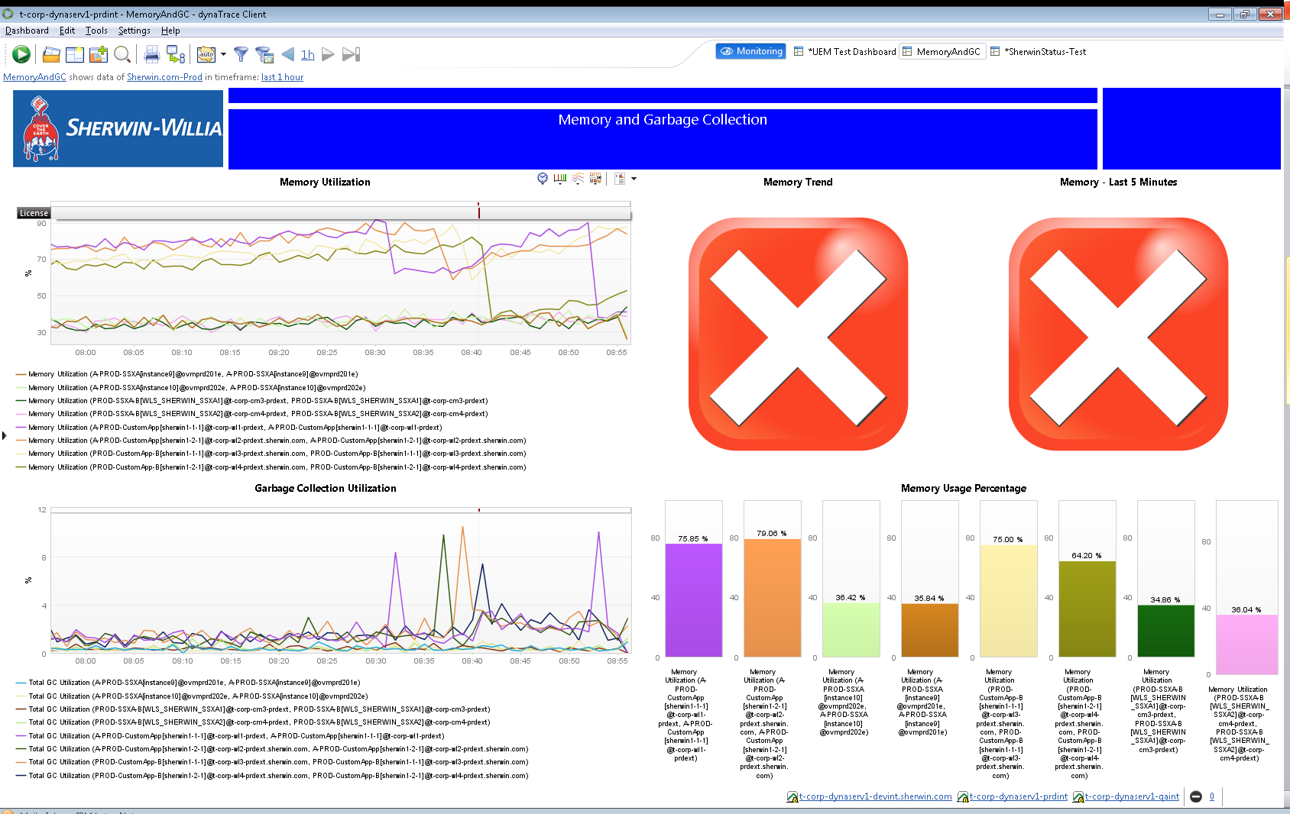
Development + QA + APM
Portfolio Level
Business Dashboard
Operations Dashboard + Alerting

Slide 34
Data
Data
Development
Configuration
Management
DBA

Slide 35



Development + CM + DBA
Create reproducible databases and data extracts just like application code … but it’s a lot more complex.

Slide 36
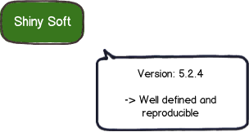
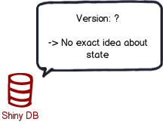
Development + CM + DBA
Why database migrations?
What state is the database in on this machine?
Has this script already been applied or not?
Has the quick fix in production been applied in test afterwards?
How do you set up a new database instance?

Slide 37
Bringing it all together
Orchestration and automated deployments and rollbacks of applications
Data
Code
Tests
Environments

Slide 38

Bringing it all together
Orchestration and automated deployments and rollbacks of applications
Code
Environments
Data
Tests

Slide 39
DevOps
One team cannot do it all …
Must be a joint collaboration effort!
Code
Environments
Data
Tests

Slide 40

Top 5 Takeaways
Don't boil the ocean, start small and make a minimum viable product
Partner with teams for extra bandwidth and to avoid creating a silo
Know your vision - make a score based maturity model
Have the business help prioritize new work items
Make your work visible - demo everything to business and IT

Slide 41

Here’s what I‘m looking for help with
Getting others in the organization to help grow roots in their areas without me working with them to do so

Slide 42

Questions?

